Slide 1
End-to-End E-Commerce Data Integration & Business Intelligence Project
A Presentation by Goshen Commerce Ltd.
Submitted: 23rd August, 2026.

Slide 2
Introduction
This project was undertaken by Group 3 Data analysts from Goshen Commerce Ltd.
Five datasets – olist_customers, olist_order_items, olist_order_payments, olist_orders, olist_products.
Power Bi was our tool of choice.
Our objectives were: Assess data quality; Clean and prepare messy data; Merge multiple datasets correctly; Analyze data effectively; Build a professional dashboard; Present actionable business insights

Slide 3
Data Issues Identified
The data types in each dataset needs to be corrected
olist_orders and olist_products datasets have missing values.
No duplicates detected.
No inconsistent formats although the text cases were mostly lower case.

Slide 4
Data Cleaning Process
Power Bi automatically put in the correct data types for some columns, other columns were manually fixed.
Formats were also corrected – Uppercase, Capitalized first word, Trimmed and cleaned texts.
Missing values were replaced with “null”
Some columns were renamed.
Format (Upper Case, Capitalize) | customers.customer_city, customers.customer_state, order_payments.payment_type, orders.order_status, products.product_category_name
Data types changed | orders. order_estimated_delivery_date, order_payments. payment_value, order_items.price, order_items.freight_value
Null | products.product_category_name

Slide 5
Data Merging Strategy
Identified the primary keys in each dataset
Used olist_order_items as the base table (fact table)
Left Join was the join technique used.
order_items >> orders >> customers >> products >> order_payments

Slide 6
Dataset | Key | Related key(s)
customers | customer_id | orders.customer_id
orders | order_id | order_items.order_id; order_payments.order_id
order_items | order_id | orders.order_id;
order_payments | order_id | orders.order_id
products | product_id | order_items.product_id

Slide 7
Dashboard Explanation
Two KPIs – Total Revenue and Total Orders
Four charts –
Sales Trend over Time
Best Selling Products
Most Used Payment Methods
Top 5 Performing States
Used Goshen colors

Slide 8
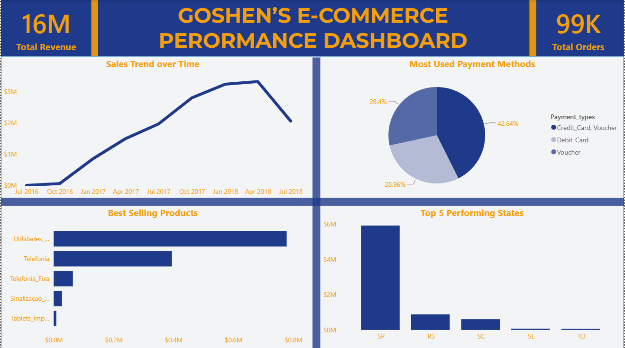

Slide 9
Key Insights
Revenue is geographically concentrated. Sao Paulo alone contributed 37.4% of delivered payment.
There is massive growth in Revenue from January 2017 to January 2018 but November 2017 was the highest revenue month.
Most used payment type was the Credit card, Voucher method which holds about 43% of total revenue.

Slide 10
Business Recommendations
Improve performance in weaker states by developing targeted promotions and strengthen marketing and customer engagements.
The organization must stop overlooking the decline in sales trend and poor performing products. Investigate the decline in sales, products and payment options.
Invest in promotion and inventory increase for Best selling products. Focus heavily on the most used payment methods and optimize them for more customers in different regions.

Slide 11
Group Names and Roles
Joshua Ahams – Data Quality Assessment, Dashboard, Data cleaning, Presentation,
Favour Moyinoluwa Ajakaye – Data Quality Assessment, Dashboard, Data cleaning
Pinima Godpower Rufus – Data cleaning, Dashboard,
David Miracle Uchechi – Data cleaning
Iye Akintayo Isaiah – Data merging
Osarumwense James – Data modeling, Key Insights, Business Recommendation
Ibrahim Sukuralahi Abiodun – Data modeling

